Slide 1
FIT1045 Introduction to Algorithms and Programming Lecture 18 Transform and Conquer
COMMONWEALTH OF AUSTRALIA
Copyright Regulations 1969
WARNING
This material has been reproduced and communicated to you by or on behalf of Monash University pursuant to Part VB of the Copyright Act 1968 (the Act).The material in this communication may be subject to copyright under the Act.Any further reproduction or communication of this material by you may be the subject of copyright protection under the Act.
Do not remove this notice.

Slide 2
Transform and Conquer
Transform
Simpler Instance Problem instance to a simpler instance of same problem
Another Representation Different representation of same instance
Another Problem Instance Problem instance to instance of different problem
Conquer
Solve the problem

Slide 3
Overview
Anagrams
Binary Trees
Heaps
Heap Sort

Slide 4
Finding Anagrams
Given a dictionary of English words,
find all sets of anagrams.

Slide 5
The Approach
Key
Data
Dictionary
Records
Sorted List
pans
anps | pans
anps | pans
pots
opst | pots
anps | snap
snap
anps | snap
opst | pots
stop
opst | stop
opst | stop
tops
opst | tops
opst | tops
Notes:
Describe a record as a data structure that allows you to combine different types of data. Describe the key, i.e., it’s the letters of the data sorted in alphabetical order. Describe how if we sort the list of records using the key, the anagrams appear together.

Slide 6
What type of transformation has occurred? A) Simpler instance B) Representation change C) Problem reduction D) None of the above
Problem Instance: Dictionary of English Words

Slide 7
Main Algorithm
For (each word in the dictionary)
{
Construct a record
Add the record to a list
}
Sort the list of records by key
Find records with the same key

Slide 8
Main Algorithm
aList = []
for word in dictionary:
"Construct a record [key, word] "
record = constructRecord(word)
"Add the record to a list“
aList.append(record)
"Sort the list of records by the key“
sortByKey(aList)
"Find records with the same key“
findIdenticalKeys(aList)

Slide 9
Tree Terminology

Slide 10
Tree Terminology
Root
Inner
Inner
Leaves

Slide 11
Tree Terminology
Parent
Children

Slide 12
Tree Terminology
Subtree

Slide 13
Tree Terminology
Subtree

Slide 14
Binary Tree
Every node has at most two children. Every subtree is a Binary Tree
Note: Empty tree is also a binary tree

Slide 15
How many different binary trees are there with 3 nodes?
1
3
5
None of the above

Slide 16
Binary Search Tree
For every node:
The values of the nodes in the left subtree are less than its value.
The values of the nodes in the right subtree are greater than its value.
12
FIT1045: Binary Search Trees do not have duplicate values
8
18
3
10
20
15
5
9
13
16
Note: Every subtree is a Binary Search Tree
Notes:
Explain this definition.

Slide 17
Is this a binary search tree?
12
7
18
8
9
20
16
2
6
10
13
Yes
No

Slide 18
Is this a binary search tree?
12
8
18
3
10
20
15
5
9
13
16
Yes
No

Slide 19
Two Operations for Binary Search Trees
12
8
18
3
10
20
15
5
9
13
16
Search
Insert
Notes:
Explain how we search for a number in a Binary Search Tree, and how we insert a number in a Binary Search Tree.

Slide 20
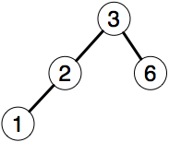

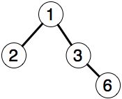
The binary tree that results from inserting the elements of the list [3,2,6,1] is:
A)
B)
.
.
.
.
C)
D) None of the above

Slide 21
Conquer (Search for element) Unsorted list – check at most n elements Binary Search Tree – check at most h elements
Transform list [3,2,6,1] of n elements to binary search tree of height h:
.
.
.
.

Slide 22
min-Heap
For every node:
The values of the children are greater or equal to its value.
All the levels are filled, except possibly the last one, which is filled left to right.
2
8
5
12
10
6
8
20
15
19
23
9
There is a similar definition for max-Heap
Notes:
Explain this definition.

Slide 23
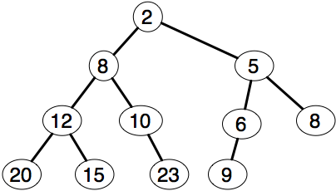
The following tree is a min-Heap.
Yes
No
Notes:
Look at node 10!

Slide 24
Two Operations on min-Heaps
2
8
5
12
10
6
8
20
15
19
23
9
Insert.
Remove minimum.
Notes:
Describe how we insert a number in a Heap, and how we remove the minimum from the Heap.

Slide 25
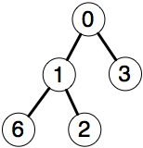
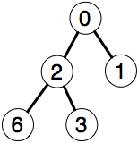
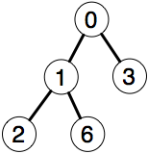
Inserting the elements [2, 1, 3, 6, 0] into a min-heap results in:
A)
B)
.
.
.
.
C)
D) None of the above

Slide 26
List [2, 1, 3, 6, 0] is transformed into the heap:
.
.
.
.
Conquer – find the minimum
- Unsorted list (look at n elements)
- Min Heap (look at one element)

Slide 27
Heap Sort
Add every item from a list to a min-Heap
Keep taking the minimum off the heap and adding it to the end of the list

Slide 28
List [2, 1, 3, 6, 0] is transformed into the heap:
.
.
.
.
Conquer – heap sort gives a sorted list

Slide 29
Before Next Lecture
Read: Introduction to the Design and Analysis of Algorithms (3rd Edition)
Transform and Conquer page 227
Heaps and Heapsort pages 252-258
Binary Search Trees pages 59-61
Log onto the FIT1045 Moodle site:
Watch the following video:
Big O Notation

